Slide 1
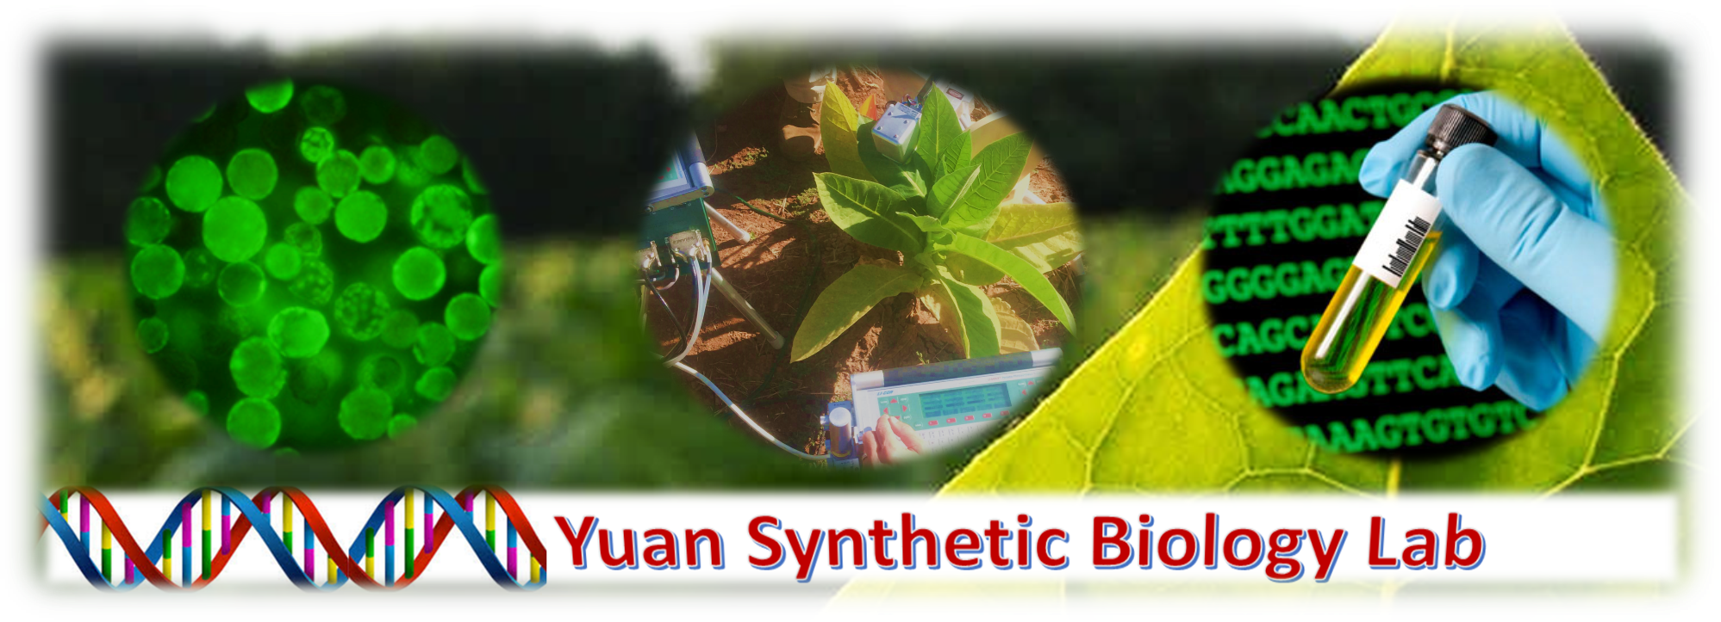
Located in Borlaug Center for Southern Crop Improvement
Looking for an on campus job?
Work experience toward your major?
What you will learn:
-Greenhouse management
-Basic molecular biology
-In vitro biology techniques
-Primer in synbio lab protocols
Undergraduates with at least a 3.0 GPA and able to work 12-15hrs/week apply to work within a lab focused on renewable synthetic biology.
How To Apply:
1. Be a Crop and Soil Sciences, BESC, or related major (undecided/undeclared ok) with a >3.0 GPA
2. Send CV or résumé to cgorm42691@tamu.edu along with statement of purpose (why you are studying ___)
We work to make renewable and sustainable methods and bioproducts in our lab everyday!
http://people.tamu.edu/~syuan/

